Slide 1
On the necessity of the rehabilitation of the citizen: peacebuilding and EU accession strategy for the Western Balkans
Bucharest, June 28, 2011
Dion van den Berg
IKV Pax Christi, the Netherlands

Slide 2
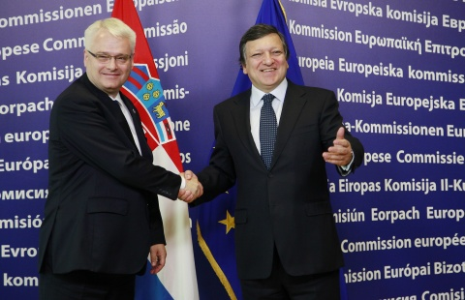
Looking into the future…

Slide 3
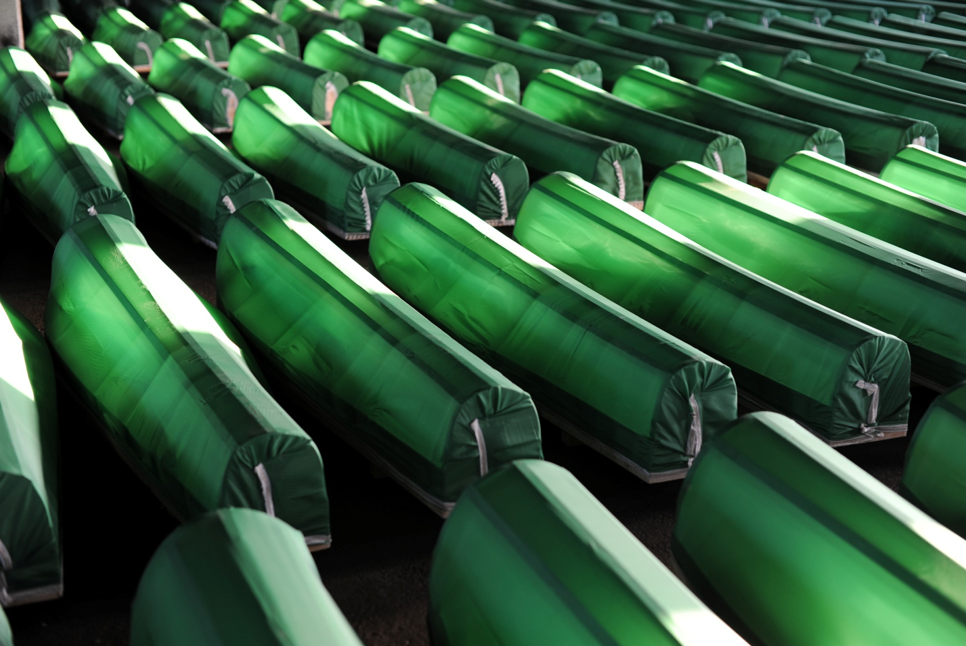
… but still haunted by the past

Slide 4
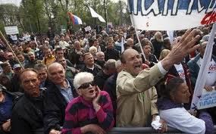
Peacebuilding priorities (1): overcoming the economic crisis

Slide 5
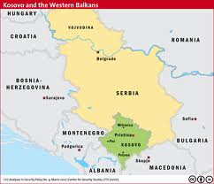
Peacebuilding priorities (2): unresolved territorial issues

Slide 6
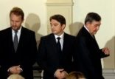
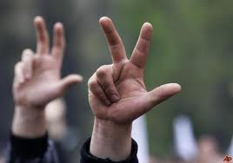
Peacebuilding priorities (3): nationalism

Slide 7
Limits of IPA (instrument pre-accession assistance)
Lack of facilities to deal with the heritages of the recent wars
Lack of motivation from the part of WB governments
Lack of motivation from the part of Brussels?
Technical and managerial approaches
Focus: institutional, top-down reform
Lack of access for small and rural NGO’s

Slide 8
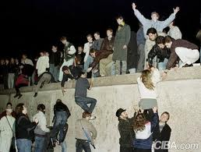
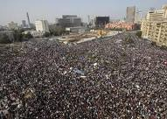
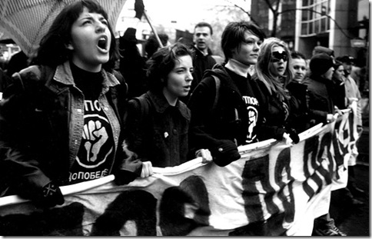
Rehabilitation of the citizen!

Slide 9
Four citizen-centred recommendations
1. widen the state-building concept
2. more focus on dealing with the past
3. extra facility for peacebuilding under IPA
4. extra support for peacebuilding outside of IPA

