Slide 1
OPSYS Presentation
How to use OPSYS?
DEVCO R4
19 March 2019

Slide 2
Agenda
Introduction to OPSYS : What is OPSYS? OPSYS Global Planning
Results and Monitoring: Key Functionalities and Milestones
Contracts and Procurement: Key Functionalities and Milestones
Presentation of Change Management

Slide 3
Introduction to OPSYS

Slide 4
What is OPSYS?
OPSYS is the new one-stop-shop for the effective and efficient management of the entire EU external relations portfolio of projects and programmes throughout the project cycle, from programming to evaluation and audit
OPSYS will integrate:
CRIS
ROM & EVAL
E-Procurement
PROSPECT
PADOR
Audit
Grant Management
GIS
OPSYS
OPSYS will interface with:
ABAC
ARES
EAMR

Slide 5
Why do we want OPSYS?
Ease of use:
Single interface covering all the workflows of the project cycle and providing access to all applications
No re-encoding
Will allow progress and completion reports to be submitted and approved online
Core and corporate indicators stored in the system for re-use
Ability to delegate tasks to colleagues
Offline mode
Automatic interface with ABAC
E-signature
User centricity:
User centred: my workplace, portfolio, projects and programmes
User friendly look and feel
Receipt of notifications about tasks pertinent to each specific user
YOU
Velocity and trustworthiness:
Faster link between progress reports and invoices
Cheaper, easier and safer tendering and grant procedures: e-signature
External users gain access to the system
Automatic generation of documentation/contracts

Slide 6
OPSYS Stakeholders
European Commission staff:
HQ, EUDs, and FPI Regional Teams
Finance and Contracts Sections
Operational Sections
Partner Countries:
NAOs
Line Ministries
Implementing Partners - Contractors:
NGOs, consulting companies, etc.
All bodies that have a contract with the EC

Slide 7
OPSYS Global Planning
Releases and Integrations

Slide 8
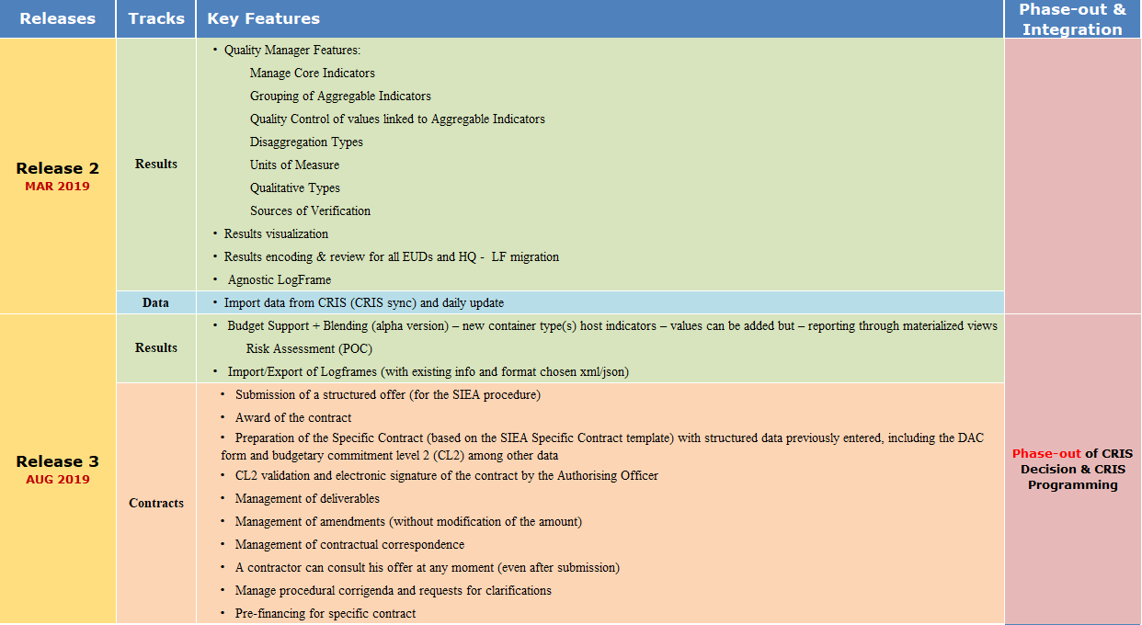
OPSYS Key Features

Slide 9
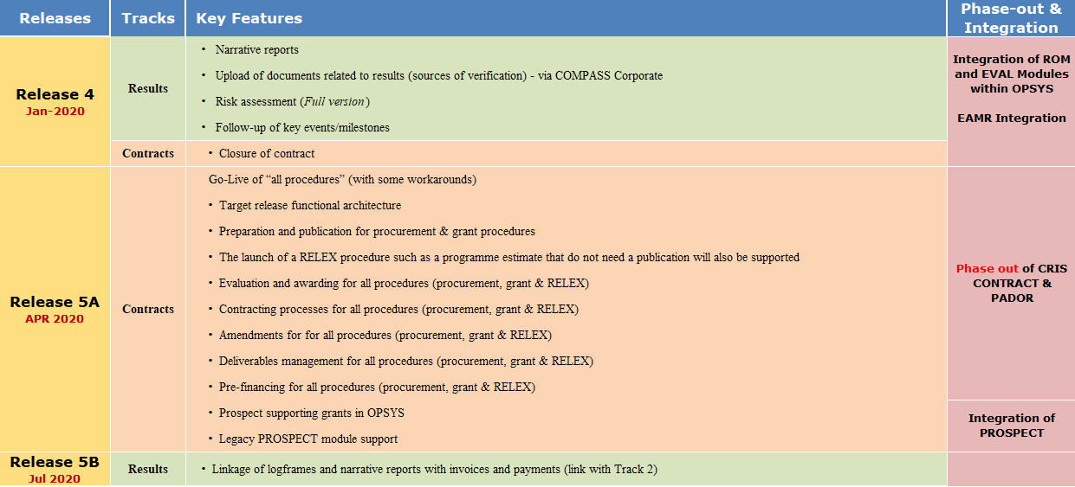
OPSYS Key Features

Slide 10
Results and Monitoring

Slide 11
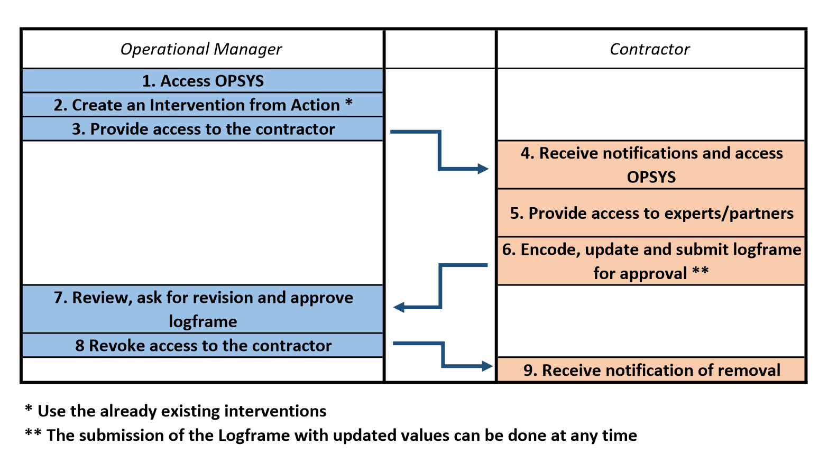
OPSYS today - Workflow

Slide 12
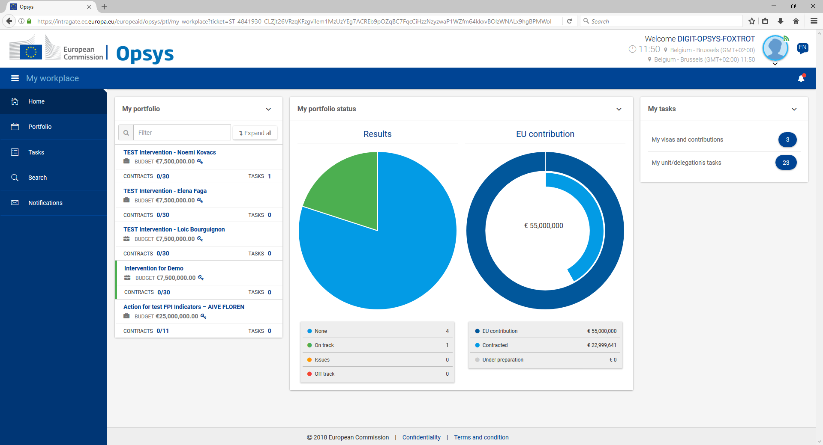
Homepage – My Workplace
Operational Manager
5
1
2
3
4
9
1-Menu
2-Overview of portfolio
3-Portfolio status
4-My tasks
5-Profile
6-Notifications
Choose an intervention

Slide 13
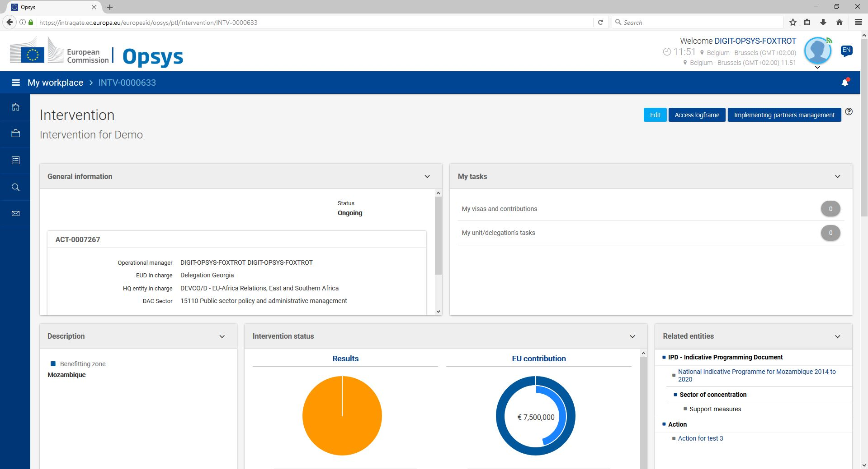
Operational Manager
6
1-General Information
2-My tasks
3-Description
4-Intervention status
5-Related entities
6-Edit; Access LFM, IP management
7-Timeline and progress
8-List of contracts and calls related to this intervention
1
2
Scroll down
3
5
4
Give access to IPs

Slide 14
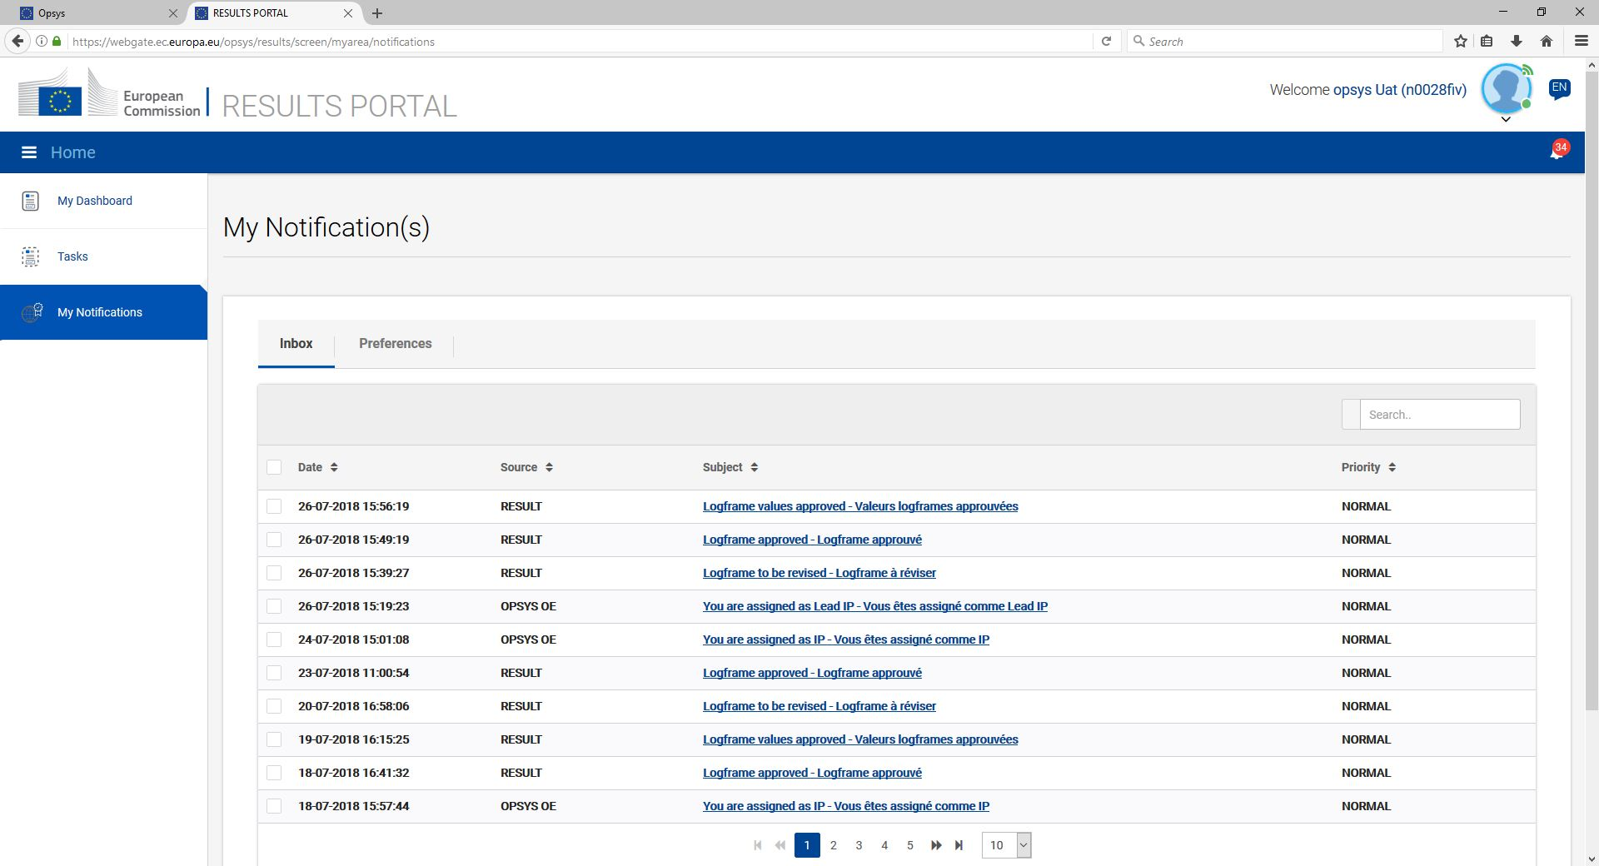
For implementing partners
Implementing Partner - Contractor
2
1
1-Menu
Dashboard
My tasks
Notifications
2-My Notifications

Slide 15
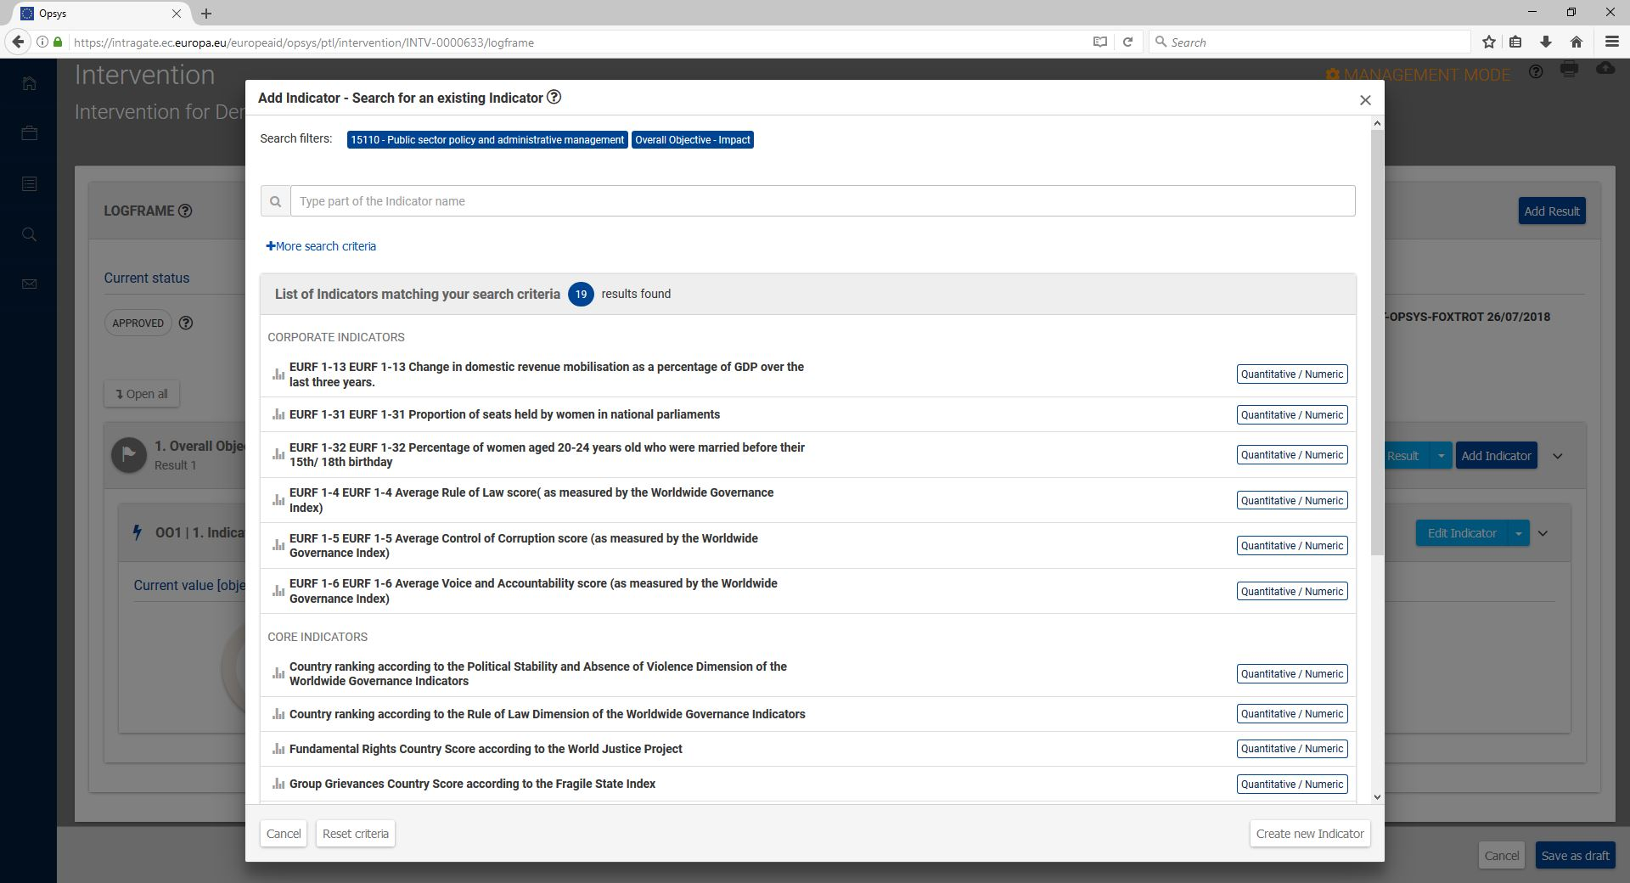
Operational Manager
Implementing Partner - Contractor
1
1-Add indicator by selecting filters

Slide 16
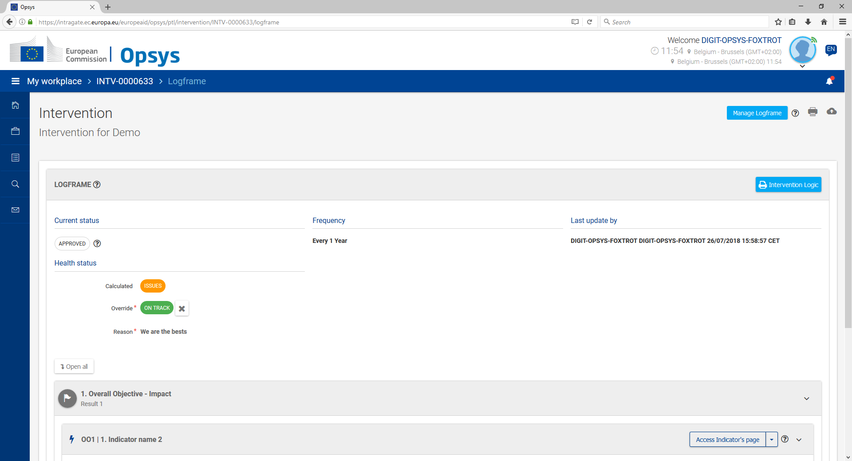
Operational Manager
Implementing Partner - Contractor
2
1
1-View LFM, current status, frequency of value reporting, timeline…
2-Manage your LFM

Slide 17
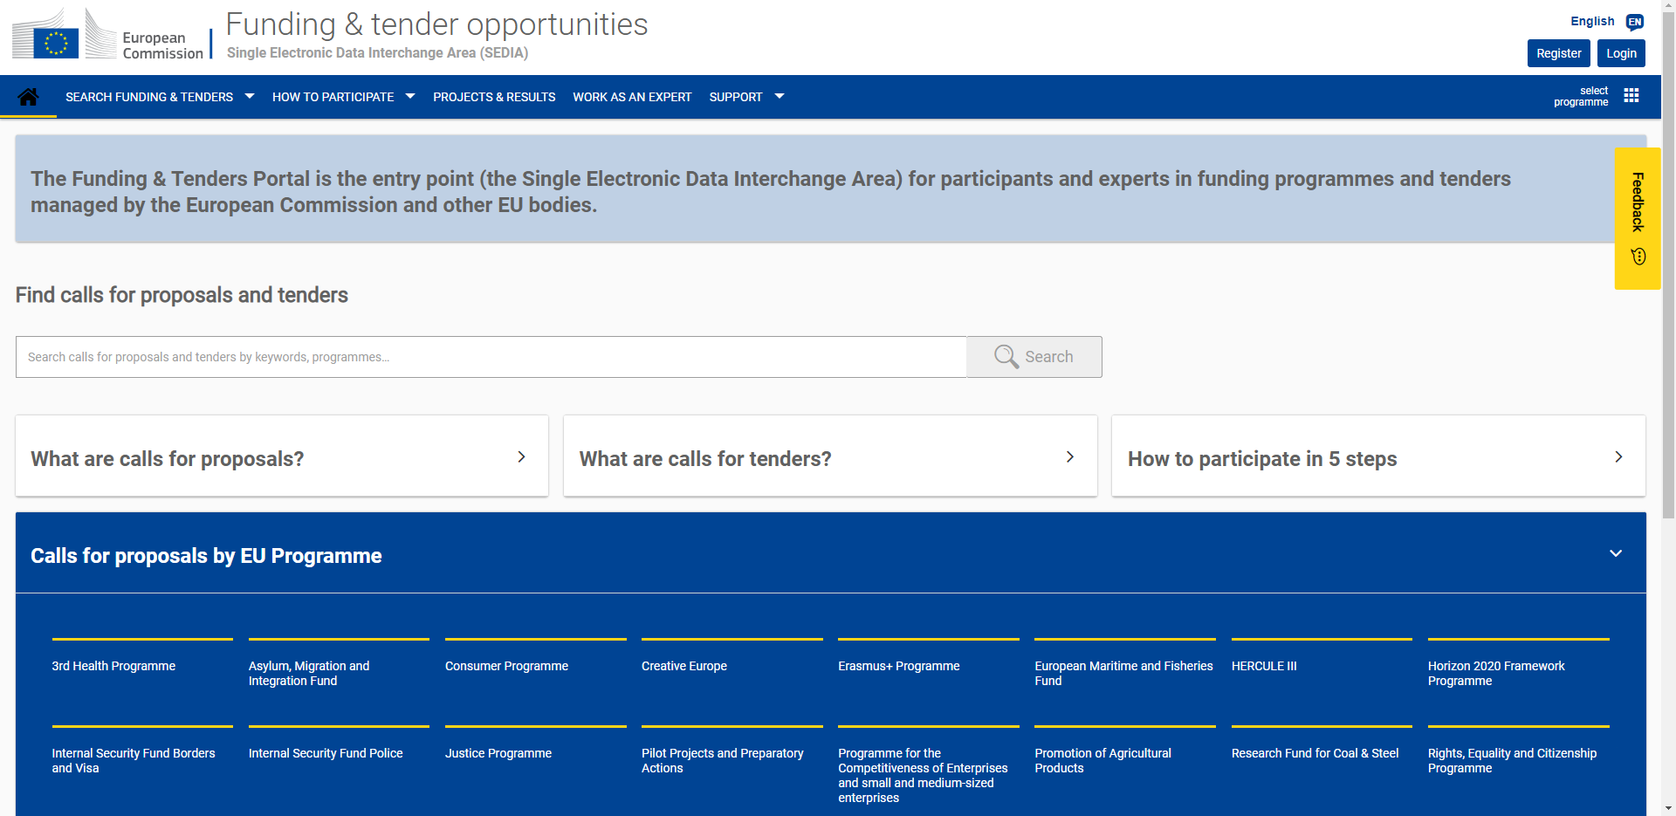
FTOP: one single entry point for all external stakeholders…
Link: https://ec.europa.eu/info/funding-tenders/opportunities/portal/screen/home

Slide 18
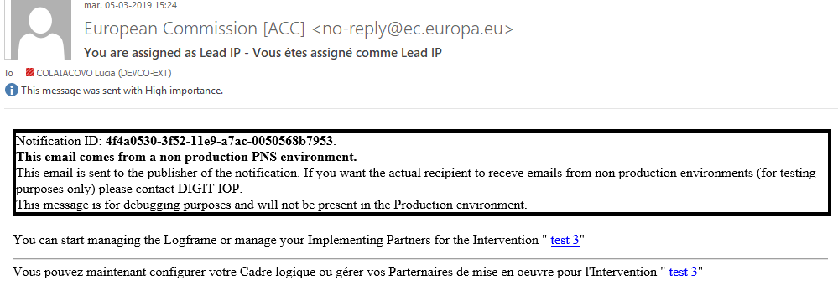
How to start using OPSYS - Implementing Partners
Step 1: Check your e-mail with the link to your Intervention. You receive the notification in your mailbox
Step 2: Click on the link and enter the Results portal. Check your portfolio of interventions.
OR
Step 3: you can add other Implementing Partners/Experts.

Slide 19
How to start using OPSYS - Implementing Partners
Step 4: Create or edit the logframe
You can now start encoding the logframe or edit the one created by the Operational Manager.
Step 5: Submit the logframe for revision and approval
Once you have finished encoding the logframe, you have to send it to your Operational Manager for approval. The Operational Manager can ask you to review the logframe.
Step 6: Add and submit current values
When the logframe has been approved (status must be “Approved”), you can add the current values and submit them to the Operational Manager. The Operational Manager can request the revision of the values submitted.

Slide 20
Contract and Procurement

Slide 21
Contract and procurement Key Functionalities
Actors
OPSYS system
European
Commission
(OIA / OVA / FIA / FVA / AO)
Contractor
Evaluation
Committee
1
Keeps up to date the forecasting plan
For other procedures than SIEA :
Publishes prior information notice / contract notice
Submits application
Evaluates and draws-up shortlist
2
7
8
Prepares the dossier
call for tender / call for proposal
Dossier is prepared with structured data
System provides guidance to the user
In addition for FWC procedures :
Draws up short list
Prepares contract
Structured data of the draft are reviewed
Commitment Level 2 if allocated on Level(s) 1
Draft contract is generated by the system with the structured data and with document of the preparation and submission
Contractor is asked to confirm availability of key experts (in case of service contract)
Sign the contract
Commitment Level 2 is validated in ABAC
Contractor electronically signs the contract
EC electronically signs the contract
The contract enters into force
Sends out invitations to submit an offer
3
Awards the contract
Pays pre-financing
6
9
Submits an offer
Offer is prepared with structured data
System provide guidance to the user
Data are encrypted for security reasons
A clock indicates the time remaining before deadline for submission
In parallel of the submission, EC can monitor the submission progress
4
Evaluates the offers
Opening session is performed
Offers are decrypted
The evaluation grid are filled
Evaluation report is uploaded
Ranking of offers is encoded
Awarding letters are prepared
5
Manage the implementation
Invoice and payment are processed in OPSYS and sent to ABAC
Contractor or EC can initiate an amendment
Deliverables are managed and archived
Progress is monitored
Expenditure Verification report are managed
Closure is performed
10
Actors and Processes of Contracts managed in Indirect Management are not represented in this slide

Slide 22
Contract and procurement module: Key improvements
Structured preparation of dossiers (tender / grant) and according to the same approach for all types of contracts
Electronic submission, with structured data
Electronic signature of contracts
Automated generation of contracts
System provides guidance to the users
(Generated
by OPSYS)

Slide 23
Change Management
Véronique Lena, Team Leader, Change Management, DEVCO R4

Slide 24
Change Management as a facilitator
OPSYS focal points in each delegation – monthly coaching through webinars
Testing phases with colleagues at each key moment of the development of the application (results, interventions and tomorrow contracts)
Embedded guidance in the application (documentation and e-learning)
Continuous support by the Change Management team on operational issues (ex: how to create an intervention). Address an email to: EuropeAid-OPSYS-USER-SUPPORT-COMMUNICATION@ec.europa.eu
Preparation of tutorials including quizzes covering all processes developed in Release 3 ( for internal and external users)

Slide 25
Key milestones for 2019
OPSYS Information sessions during Regional seminars (thematic and/or FCA)
Half-day OPSYS hands-on training during FPI Days
OPSYS workshop and stands during Cooperation Days (13-16 May 2019)
Two-days Seminar with OPSYS Focal Points, HoC and HoFCA (20-21 May 2019)
OPSYS Information session, stands and live demos during European Development Days (18-19 June 2019)
OPSYS Information session to FWC SIEA and Audit consortia (June/July 2019)
From July 2019: all OMs and FCAs colleagues will perform the tutorials.

Slide 26
Guidance: WIKIs
It will allow the users (internal and external) and OPSYS focal points to stay informed on changes and news on the upcoming releases.
It is the primary source of user support in the use of OPSYS.
It contains step-by-steps to guide the user through the most common actions.
It contains Frequently Asked Questions and e-learning videos to support the use of the system
Link to WIKI for the Internal users: My workplace
Link to WIKI for the External users: Welcome to the portal

Slide 27
e-Help
Navigating on OPSYS you will find helpful hints to help you.
By clicking on the “question mark” the user can access short texts explaining the task to be performed.
Every e-Help request will redirect to a dedicated page in the WIKIs, both for internal and external users.

Slide 28
e-Learning videos
To familiarise yourself or if you have problem performing certain steps in the system, a series of short videos has been produced to guide you, step-by-step, through the most common actions on OPSYS.
The e-learning videos can be found in the WIKIs. You can directly access them
E-learning videos for Internal users
E-learning videos for External users

Slide 29
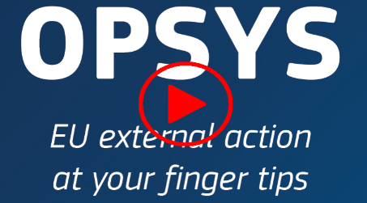
Stay tuned
Join the OPSYS Capacity4Dev group to be updated with the latest news! OPSYS group is open to both internal colleagues and external partners
Watch and share OPSYS presentation videos by opening the hyperlink:
https://europa.eu/capacity4dev/opsys

