Slide 1
Service for Foreign Policy Instruments (FPI)
"The EU's Instrument contributing to Stability and Peace" (IcSP)

Slide 2
MFF 2007 – 2013 Funding Heading IV
MFF 2014 – 2020 Funding Heading IV
€ 1.6 billion (2% of the budget for the EU External Instruments)
€ 2.3 billion (2.5% of the budget for the EU External Instruments)
Amount €bn
Notes:
OTHERS:
Humanitarian Aid
European Instrument for Democracy and Human Rights
Instrument for Nuclear Safety Cooperation
Micro-Financial Assistance
Guarantee Fund
Civil Protection
…

Slide 3
Aid under the Instrument contributing to Stability and Peace
1)Global Reach
2)Non "DACable"
3)Mobilised when other EU instruments cannot be made available in response to political crisis or natural disasters (Article 3)
Areas excluded:
Humanitarian Aid; Actions of a military nature

Slide 5
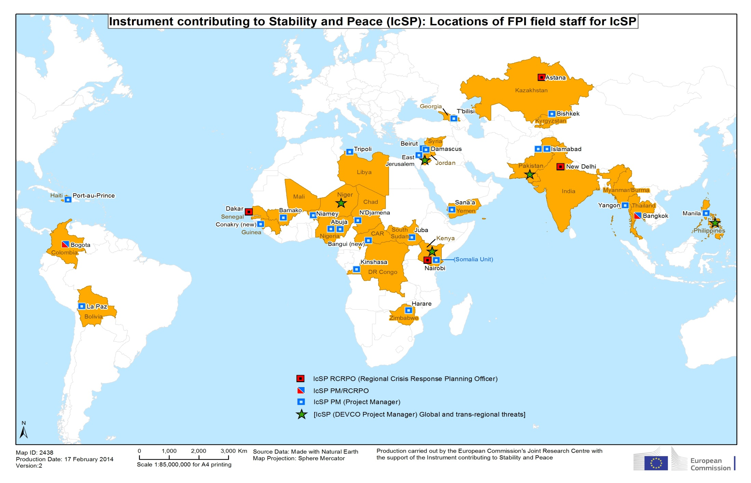

Slide 6
To which priorities did IfS Art.3 measures respond in 2013 ?

Slide 7
IfS Crisis Response implementing partners (Article 3)
2007 - 2013

Slide 8
Flowchart on how to identify and prepare IcSP interventions (Article 3)
"The Union shall ensure consistency between the different areas of its external
action and between these and its other policies. The Council and the Commission, assisted by the High Representative of the Union for Foreign Affairs and Security Policy, shall ensure that consistency and shall cooperate to that effect" (Article 21 TEU)
HR/VP
ESG
Executive Secretary General
Other Commission Services
Political endorsement
EU Member States
EEAS/FPI
Delegations
Stakeholders
UN, Regional Organizations, CSOs
Early warning system
HoMs

Slide 9
Criteria for using IcSP
Political appropriateness (Political priority for EU to intervene)
Eligibility (within legal and thematic scope set out in IcSP Regulation)
Feasibility (suitable implementing bodies; duration; continuity by other instruments)

Slide 10
IcSP: Main changes
Clearer structure of the Regulation around 3 specific objectives
No delegated acts (i.e. no possibility for the Commission to adjust the Regulation without full co-decision legislative process)
Financial allocations between the three objectives set by the legislator in the Regulation: at least 70% (art.3); 9% (art.4)
Increased flexibility for implementation

Slide 11
Instrument contributing to Stability and Peace (IcSP)
Objectives
Article 3 IcSP Regulation
(at least 70% of budget)
Assistance in response to situations of crisis or emerging crisis to prevent conflicts
"Exceptional Assistance Measures" (EAM)
"Interim Response Programmes" (IRP)
Article 4 IcSP
Regulation
(9% of budget)
Assistance for conflict prevention, peace building and crisis preparedness
Assistance in addressing global and trans-regional threats and emerging crisis:
Threats to law and order, to security and safety of individuals, to critical infrastructure and to public health
Mitigation of and preparedness against risks, whether of an intentional, accidental or natural origin, related to CBRN (chemical, biological, radiological and nuclear) materials or agents
EP Strategic Dialogue
Strategy Papers/Multi-annual indicative Programme (MiPs)
Annual Action Programmes (AAP)
Article 5 IcSP Regulation
(up to 21% of budget)

Slide 12
Exceptional Assistance Measures and
Interim Response Programmes
No Comitology
Comitology
18 months
24 months
30 months
MAX 36 months
EAM
18 months
1st
"in the event of objective and unforeseen obstacles to implementation"
1st Extension
6 months (no cost increase)
IRP
2nd Extension
6 months (no cost increase)
EAM
18 months
2nd
12 months
"in case of protracted crisis and conflict"
or
6 months
or
= New Features of IcSP Reg.
Notes:
Comitology covered by Article 15 (3) of CIR – examination procedure
Article 7(2) covers conditions for I and II EAM

Slide 13
IcSP reporting mechanisms
PSC Note
Article 7(4) IcSP Reg.
New measures if ≤20 million
Updates
Substantive changes
Ongoing measures
Ad-Hoc Note (report after 3 months)
Article 7(5) IcSP Reg.
ARTICLE 3
Duly inform EP "in a timely manner" about planning, implementation, substantial changes or extensions
Article 7(7) IcSP Reg.
All External Action Instruments
Annual Report
Article 13 Common implementing Reg. (CiR)

Slide 14
New features of IcSP
General
Alignment to the Union's external actions policies
(Article 21, Treaty on European Union)
Strengthened involvement of civil society actors (Art.9)
Human rights: ensuring measures on the fight against terrorism and organised crime are implemented in accordance with international law, including international humanitarian law (Art. 10)
Cross-cutting issues for Articles 3, 4 & 5
    promotion of democracy and good governance
    human rights and humanitarian law, including children's rights and the rights of indigenous peoples
    non-discrimination
    gender equality and empowerment of women
    conflict prevention
    climate change
Notes:
Strengthened involvement of civil society actors:
Article 1(3): [updated legal understanding of civil society actors] "the term 'civil society actors' includes non-governmental organisations, organisations representing indigenous peoples, local citizens' groups and traders' associations, cooperatives, trade unions, organisations representing economic and social interests, local organisations (including networks) involved in decentralised regional cooperation and integration, consumer organisations, women's and youth organisations, teaching, cultural, research and scientific organisations, universities, churches and religious associations and communities, the media and any non-governmental associations and private and public foundations likely to contribute to the development or to the external dimension of internal policies"
Article 9: [consultation on preparing, programming, implementing and monitoring actions] "The preparation, programming, implementation and monitoring measures under this Regulation shall be carried out, where possible and where appropriate, in consultation with civil society"

Slide 15
Subject matter and principles
Article 1 CIR
Common Implementing Regulation
Development Coopereation Instrument (DCI) | European Neighborhood Instruments (ENI) | Instrument for Pre-Accession (IPA II) | Partnership Instrument (PI) | Greenland | EDF outside of MFF
European Instrument for Democracy and Human Rights (EIDHR)
Instrument for Nuclear Safety Cooperation (INSC)
Instrument for Stability and Peace (IcSP)

Slide 16
Common Implementing Regulation for all instruments (except EDF)
All implementation provisions - i.e. annual programmes, reporting, evaluation, etc. – moved into a single common Regulation to avoid discrepancies between instruments, as in the past.
New harmonised procedures common to 4 geographic instruments (DCI, ENI, IPA, and PI) and 3 thematic instruments (IcSP, EIDHR, INSC)
Provisions on implementation significantly simplified (consistency with the review of the Financial Regulation)
Use of innovative financial tools (e.g. blending)
Specific situation of IPA and ENI where the special characteristics of pre-accession and cross-border cooperation will require additional implementing rules and procedures

Slide 17
Provisions on financing methods
Structure:
Article 4-5: general provisions – applicable to all
Article 6: special provisions – applicable to DCI, ENI, IcSP, IPA II
Article 4 (7): indirect management
- subdelegation, subdelegation to NGOs
- annual reporting
- pillar assessment

Slide 18
Provisions on
financing methods
Template for agreements in indirect management - PAGODA
Pillar Assessed Grant Or Delegation Agreement
For entities who meet the selection criteria of Art. 139 of the Financial Regulation
Negotiations are nearly finalised

Slide 19




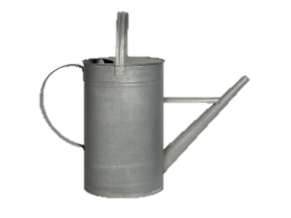








EU Trust Funds
Jointly Co-financing Donors
EU
Trust Fund
Commission-administered EU Trust Fund
Final Recipients

Slide 20
EU Trust Funds: comparison
 | European Development Fund | EU Trust Fund
legal entity | NO | NO
scope | ACP Countries | - crisis & post-crisis (Mali, Syria…) - thematic (in principle global)
created by | all MS's Internal Agreement, Council Regulations | Commission decision with Comitology (constitutive act) + another donor
duration | fixed agreed, funds available for that duration | the same
governance | Commission decision with Comitology, Authorising Officer by Delegation | board of donors Commission chairs and has veto MS as observers, if not donors
implement-tation | Commission + Indirect Management | Commission + limited but sufficient Indirect Management for CPCTF: Partner Countries, International Organisations, Member States Agencies
rules | Companion, PRAG, internal Commission systems | the same, but simplified to speed up delivery of CPCTF?
running costs | max. 2 % of volume for administration | max. 5 % of volume for administration

Slide 21
Provisions on financing methods
Article 5 – taxes:
  For the beneficiary country: specific tax on EU aid is banned (1st sentence);
  For the Commission: negotiate whenever possible the exemption of EU aid from taxes (2nd sentence);
  For beneficiaries: where tax is a final cost of the project it will be eligible in accordance with the rules of the FR (3rd sentence).

Slide 22
Rules of nationality and origin
Harmonising and simplifying
Article 8
harmonise
common rules
Untie origin
≤ 100 000 EUR
Endorsing
EU international commitments
Article 8
Articles 9 and 11
widen eligibility
More eligible
countries
Reciprocity
DAC members
EIDHR IcSP
untied
Keeping justified
specificities
Articles 9,10 ,11
reflect specificity
of each instrument

Slide 23
Focus on performance results
Court of Auditors: more focus on impact of spending and results
Commission: required to develop a results framework
Apply to all instruments / spending: Financial Regulation requires indicators and targets for all spending
Impact indicator required for general objectives and performance indicators for each specific objective
Some included in the legal bases (e.g. PI Regulation)

Slide 24
New Financial Regulation 966/2012
changes guided by three objectives to increase:
  Simplification of rules and procedures
  Accountability in the implementation
  Leverage of Union funds
accompanied by Rules of Application (Commission Delegated Regulation No 1268/2012), replacing the Implementing Rules (Commission Regulation No 2342/2002)
applicable mostly from 1 January 2013, but on Methods of Implementation and Financial Instruments from 1 January 2014, replaces the old FR No 1605/2002

Slide 25
Grants
Financial Support to third parties
(Sub-granting)
- Sub-granting may become the main aim of the action
- Sub-grant per third party increased to € 60.000, with no overall ceiling
- No limits per sub-grant when the financial support is the pri-
mary aim of the action

Slide 26
Grants
Simplified Cost Options
(lump sums, unit costs, flat-rate financing)
- Limited to € 60.000 per beneficiary of the grant contract
(exclusive of the 7% of indirect costs)
- Proposed by the beneficiary
- The approval to the use of the SCO will be given by the Contracting Authority during the contracting phase
- Guidelines and check-list have been developed

Slide 27
Grants
Simplified Cost Options
(lump-sums, unit costs, flat rate financing)
- The methods used by the Beneficiary(ies) to determine the simplified cost options must be clearly described in Annex III (justification sheet of the budget).
- Can be based on:
  Statistical data or other external data as appropriate
  Certified or auditable historical data of the Beneficiary(ies)
  Actual accounting or cost accounting data of the Benefi-
ciary(ies)

Slide 28
CONTRACTUAL MATTERS
Grants

Slide 29
Grants
Interest on pre-financing
- They are not due to the Union any more
- No need to open interest bearing accounts
- No more reporting

Slide 30
Grants
Guarantee on PRE-FINANCING
- No right to ask for it !! - May be requested based
on risk analysis
- Shouldn't be requested if the Coordinator is a No- Profit organisation, gov.
Department or public body,
or signatory of a Framework agreement with the EC
Grants
≤ 60 000
Grants
> 60 000

Slide 31
Grants
Payment deadlines
- One SINGLE time limit
- No more SUB limits for approval / payment periods
- 30 / 60 / 90 depending on type of payment

Slide 32
Grants
Payment procedures
- For Option 2 (actions > 12 months and > € 100 000)
- Initial pre-financing increased to 100% of first year budget financed by the CA

Slide 33
Grants
Expenditure Verification report
> € 750 000 > € 5 000 000
> € 100 000 > € 100 000
  Detailed breakdown of expenditure with every other
  request for further pre-financing
Previous versions
2013
Choice of auditor
With any request for pre-financing in case of grant contracts:
With any final report in case of grant contracts:
When the expenditure verification is not required:

Slide 34
Grants
Amendments to the contract
- Ceiling increased from 15% to 25% for transfers between main budget headings
- Not to be used to modify:
- amounts or rates of the simplified cost options
- in-kind contribution
- indirect costs

Slide 35
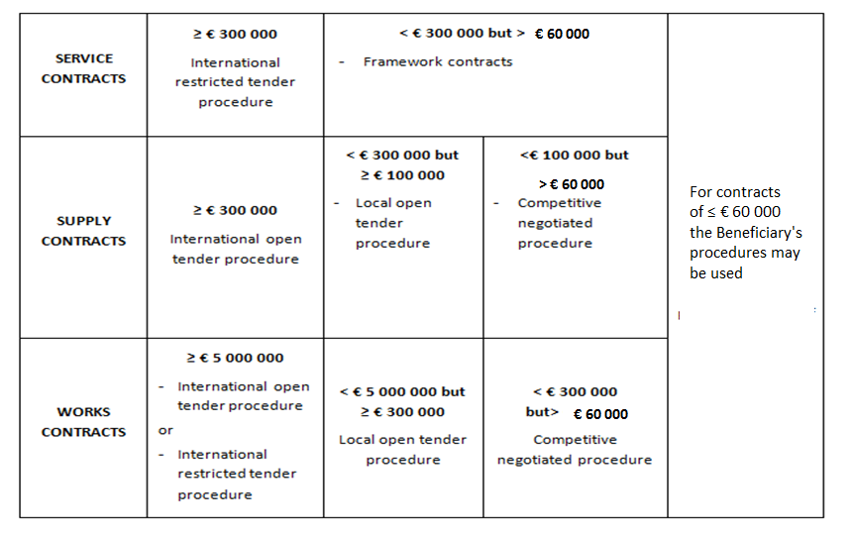
Grants
Annex IV
- Updated according to new thresholds

